Slide 1
Proposed Changes to Deed Restrictions
Woods of Wimbledon Civic Association, Inc.

Slide 2
Executive Summary
The Original Deed Restrictions were filed in September of 1977 to reflect the restrictions placed on a vacant plot of land to be developed by McCrory Hallbeck DCI (the “Developer Entity”)
The needs of the Association and the Subdivision mandate an overhaul to the Restrictions. This slideshow is a summary of my proposed changes, including:
Addition of definitions to provide clarity
Removal of numerous reference to the Developer Entity that are no longer relevant
Changes to the ACC language to reflect the existing nature of the Committee
Consolidation and numbering of owner restricted activities to ease enforcement
Changes to the Modification Procedure to allow for modification at any time with 2/3 vote of the Members

Slide 3
Recitals
These are added to give context to the document and to serve as a statement to the validity of the document. As applicable here -
The first recital describes the Original Deed Restrictions, the Subdivision and the Developer Entity
The second recital states the conditions necessary for the Members to revise the Original Deed Restrictions
The third recital states that the conditions have been met and accordingly the Amended Deed Restrictions are valid and binding

Slide 4
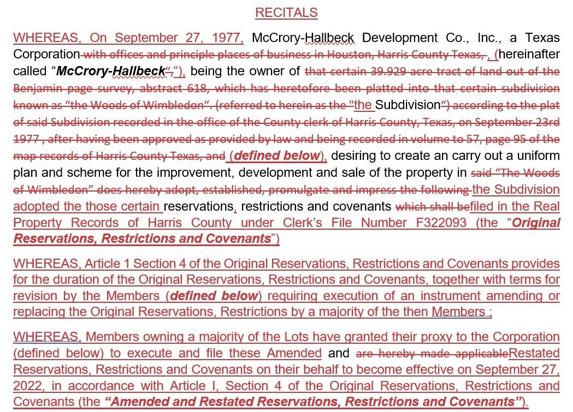

Slide 5
General Provisions
Overview of Changes
Added Definitions
Incorporated defined terms into the body of the document as necessary
Removed the 35-year duration term and moved to a 10-year evergreen model

Slide 7
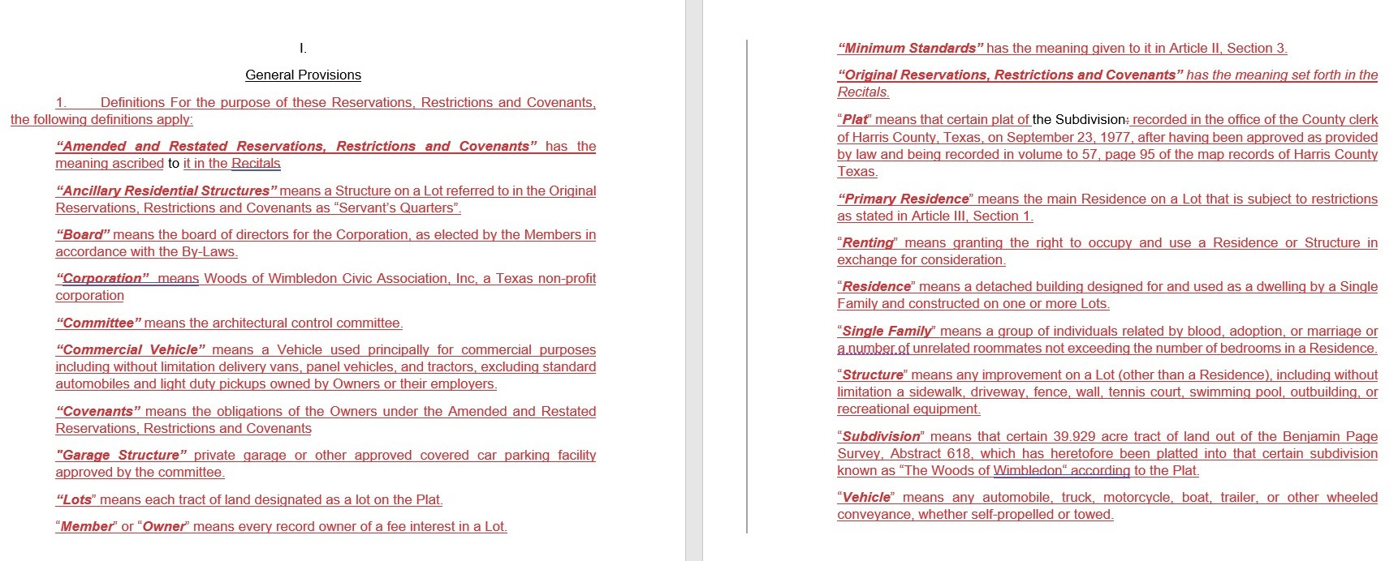

Slide 10
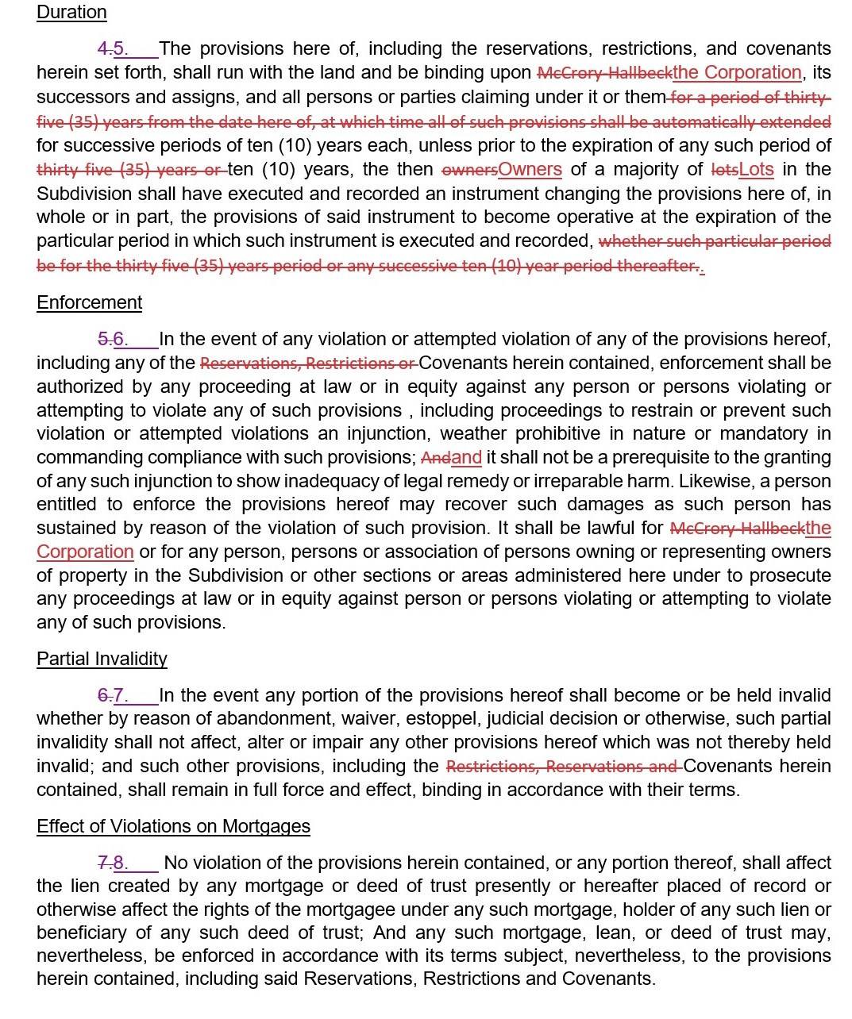

Slide 11
Architectural Control
Overview of Changes
Incorporated Defined Terms
Removed Developer Entity and Formation References
Streamlined removal/replacement and election process

Slide 17
General Restrictions
Overview of Changes
Incorporated Defined Terms
Removed Developer Entity and Formation References
Consolidated and Streamlined Owner Restricted Activities

Slide 30
Maintenance Fund
Overview of Changes
Incorporated Defined Terms
Removed Developer Entity and Formation References

Slide 32
Maintenance Corporation
Overview of Changes
Incorporated Defined Terms
Removed Developer Entity and Formation References

Slide 34
Additional Area
Deleted this section as inapplicable

Slide 36
Binding Effect
Overview of Changes
Incorporated Defined Terms
Removed Developer Entity and Formation References

Slide 38
Modifications
Overview of Changes
Incorporated Defined Terms
Removed Developer Entity and Formation References
Changed to a Modification by 2/3 vote of the Members

